Slide 1
Java Basics

Slide 2
Naming convention
Naming conventions are used to make Java programs more readable.
It is important to use meaningful and unambiguous names.
Class Names
Class names should be nouns, as they represent “things” or “objects.”
They should be mixed case (camel case) with only the first letter of each word capitalized, as in the following:
public class InsurencePremium {...}

Slide 3
Interface Names
Interface names should be adjectives.
They should end with “able” or “ible” whenever the interface provides a capability; otherwise, they should be nouns.
Interface names follow the same capitalization convention as class names:
public interface Serializable {...}
public interface SystemPanel {...}

Slide 4
Method Names
Method names should contain a verb, as they are used to make
an object take action.
They should be mixed case, beginning with a lowercase letter, and the first letter of each subsequent word should be capitalized.
Adjectives and nouns may be included in method names:
public void locate() {...} // verb
public String getWayPoint() {...} // verb and noun

Slide 5
Instance and Static Variable Names
Instance and static variable names should be nouns and should
follow the same capitalization convention as method names:
private String wayPoint;

Slide 6
Parameter and Local Variable Names
Parameter and local variable names should be descriptive lowercase single words, acronyms, or abbreviations.
If multiple words are necessary, they should follow the same capitalization convention as method names:
public void printHotSpots(ArrayList spotList) {
int counter = 0;
for (String hotSpot : spotList) {
System.out.println("Hot Spot #“ + ++counter + ": " + hotSpot);
}
}
Temporary variable names may be single letters such as i, j, k, m, and n for integers and c, d, and e for characters.

Slide 7
Generic Type Parameter Names
Generic type parameter names should be uppercase single letters.
The letter T for type is typically recommended.
The Collections Framework makes extensive use of generics. E is used for collection elements, S is used for service loaders, and K and V are used for map keys and values:
public interface Map <K,V> {
V put(K key, V value);
}

Slide 8
Constant Names
Constant names should be all uppercase letters, and multiple words should be separated by underscores:
public static final int MAX_DEPTH = 200;

Slide 9
Enumeration Names
Enumeration names should follow the conventions of class names.
The enumeration set of objects (choices) should be all uppercase letters:
enum Battery {CRITICAL, LOW, CHARGED, FULL}

Slide 10
Package Names
Package names should be unique and consist of lowercase letters.
Underscores may be used if necessary:
package com.valueslabs.pams;
Publicly available packages should be the reversed Internet domain name of the organization, beginning with a single-word top-level domain name (e.g., com, net, org, or edu), followed by the name of the organization and the project or division.

Slide 11
Annotation Names
Annotation names have been presented several ways in the Java SE API for predefined annotation types, [adjective|verb][noun]:
@Documented
@Retention(RetentionPolicy.RUNTIME)
@Target(ElementType.TYPE)
public @interface FunctionalInterface {}

Slide 12
Acronyms
When using acronyms in names, only the first letter of the acronym
should be uppercase and only when uppercase is appropriate:
public String getGpsVersion() {...}

Slide 13
Lexical Elements
Java source code consists of words or symbols called lexical elements or tokens.
Java lexical elements include:
line terminators, whitespace,
comments, keywords, identifiers,
separators, operators, and literals.
The words or symbols in the Java programming language are comprised of the Unicode character set.

Slide 14
Unicode and ASCII
Maintained by the Unicode Consortium standards organization,
Unicode is the universal character set with the first 128 characters being the same as those in the American Standard Code for Information Interchange (ASCII) character set.
Unicode provides a unique number for character, usable across all platforms, programs, and languages.
Java 9 is supporting Unicode 8 version.
Java comments, identifiers, and string literals are not limited to ASCII characters.

Slide 15
Printable ASCII Characters
ASCII reserves code 32 (spaces) and codes 33 to 126 (letters, digits,
punctuation marks, and a few others) for printable characters.
Table contains the decimal values followed by the corresponding
ASCII characters for these codes.

Slide 16
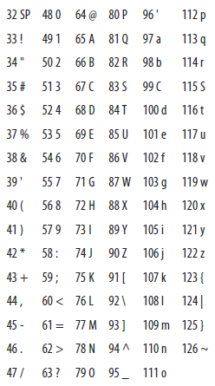

Slide 17
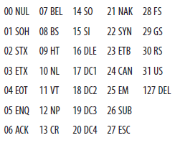
Nonprintable ASCII Characters
ASCII reserves decimal numbers 0–31 and 127 for control characters.

Slide 18
Comments
A single-line comment begins with two forward slashes and ends immediately before the line terminator character:
// A comment on a single line
A multiline comment begins with a forward slash immediately followed by an asterisk, and ends with an asterisk immediately followed by a forward slash. The single asterisks in between provide nice formatting convention; they are typically used, but are not required:
/*
* A comment that can span multiple lines
* just like this
*/

Slide 19
A Javadoc comment is processed by the Javadoc tool to generate API documentation in HTML format. A Javadoc comment must begin with a forward slash, immediately followed by two asterisks, and end with an asterisk immediately followed by a forward slash:
/** This is my Javadoc comment */
In Java, comments cannot be nested:
/* This is /* not permissible */ in Java */

Slide 20
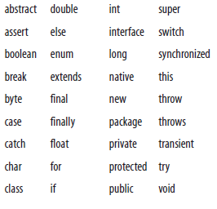
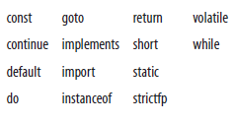
Keywords
Java keywords cannot be used as identifiers in a Java program.
Two of these, the const and goto keywords, are reserved but are not used by the Java language.

Slide 21
Identifiers
A Java identifier is the name that a programmer gives to a class, method, variable, and so on.
Identifiers cannot have the same Unicode character sequence as any keyword, boolean, or null literal.
Java identifiers are made up of Java letters. A Java letter is a character for which Character.isJavaIdentifierStart(int) returns true. Java letters from the ASCII character set are limited to the dollar sign ($), the underscore symbol (_), and upper- and lowercase letters.

Slide 22
Digits are also allowed in identifiers, but after the first character:
// Valid identifier examples
class TestDriver {...}
String testVariable;
int _testVariable;
Long $testVariable;
startTest(testVariable1);

Slide 23
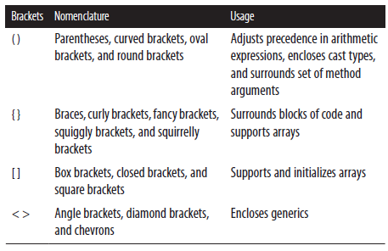
Separators
Several ASCII characters delimit program parts and are used as separators. (), { }, and [ ] are used in pairs:
() { } [ ] < > :: : ; , . ->

Slide 24
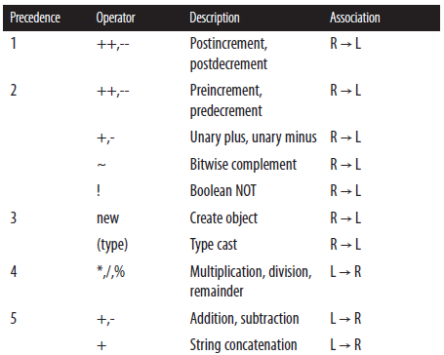
Operators

Slide 25
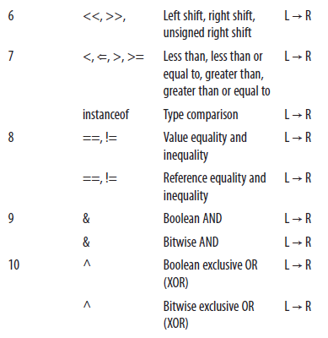
Continued…

Slide 26
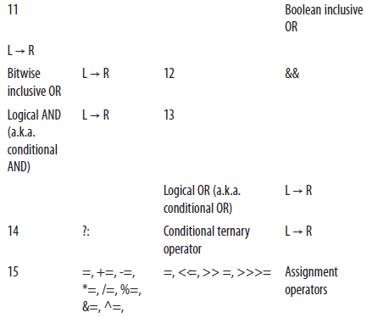
Continued…

Slide 27
Literals
Literals are source code representation of values. As of Java SE 7, underscores are allowed in numeric literals to enhance readability of the code. The underscores may only be placed between individual numbers and are ignored at runtime.

Slide 28
Boolean Literals
Boolean literals are expressed as either true or false:
boolean isReady = true;
boolean isSet = new Boolean(false); // unboxed
boolean isGoing = false;

Slide 29
Character Literals
A character literal is either a single character or an escape sequence contained within single quotes. Line terminators are not allowed:
char charValue1 = 'a';
// An apostrophe
Character charValue2 = new Character ('\'');

Slide 30
Integer Literals
Integer types (byte, short, int, and long) can be expressed in decimal, hexadecimal, octal, and binary. By default, integer literals are of type int:
int intValue1 = 34567, intValue2 = 1_000_000;
Decimal integers contain any number of ASCII digits, zero through nine, and represent positive numbers:
Integer integerValue1 = new Integer(100);
Prefixing the decimal with the unary negation operator can form a negative decimal:
public static final int INT_VALUE = -200;

Slide 31
Continued…
Hex numbers can represent positive and negative integers and zero:
int intValue3 = 0X64; // 100 decimal from hex
Octal literals begin with a zero followed by one or more ASCII digits zero through seven:
int intValue4 = 0144; // 100 decimal from octal
Binary literals are expressed using the prefix 0b or 0B followed by
zeros and ones:
char msgValue1 = 0b01001111; // O
char msgValue2 = 0B01001011; // K
char msgValue3 = 0B0010_0001; // !

Slide 32
Continued…
To define an integer as type long, suffix it with an ASCII letter L (preferred and more readable) or l:
long longValue = 100L;

Slide 33
Floating-Point Literals
A valid floating-point literal requires a whole number and/or a fractional part, decimal point, and type suffix. An exponent prefaced by an e or E is optional. Fractional parts and decimals are not required when exponents or type suffixes are applied.

Slide 34
Continued…
A floating-point literal (double) is a double-precision floating point of eight bytes. A float is four bytes. Type suffixes for doubles are d or D; suffixes for floats are f or F:
float floatValue1 = 9.15f, floatValue2 = 1_168f;
Float floatValue3 = new Float(20F);
double doubleValue1 = 3.12;
Double doubleValue2 = new Double(1e058);
float expValue1 = 10.0e2f, expValue2=10.0E3f;

Slide 35
String Literals
String literals contain zero or more characters, including escape sequences enclosed in a set of double quotes. String literals cannot contain Unicode \u000a and \u000d for line terminators; use \r and \n instead. Strings are immutable:
String stringValue1 = new String("Valid literal.");
String stringValue2 = "Valid.\nOn new line.";
String stringValue3 = "Joins str" + "ings";
String stringValue4 = "\"Escape Sequences\"\r";

Slide 36
Continued…
There is a pool of strings associated with class String. Initially, the pool is empty. Literal strings and string-valued constant expressions are interned in the pool and added to the pool only once.
The following example shows how literals are added to and used in the pool:
// Adds String "thisString" to the pool
String stringValue5 = "thisString";
// Uses String "thisString" from the pool
String stringValue6 = "thisString";

Slide 37
Continued…
A string can be added to the pool (if it does not already exist in the pool) by calling the intern() method on the string. The intern() method returns a string, which is either a reference to the new string that was added to the pool or a reference to the existing string:
String stringValue7 = new String("thatString");
String stringValue8 = stringValue7.intern();

Slide 38
Null Literals
The null literal is of type null and can be applied to reference types. It does not apply to primitive types:
String n = null;

Slide 39
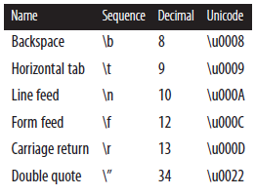
Escape Sequences

Slide 40
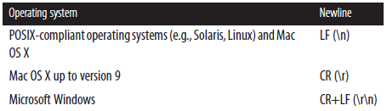
Different line terminators
System.lineSeparator()

